Slide 1
Electric Circuit Analysis-I(CPE121)
Capacitors and Inductors

Slide 2
Outline
Capacitors and Capacitance
Types of Capacitors
Capacitors in Series and Parallel
Inductors and Inductance
Inductors in Series and Parallel
Current/Voltage Continuity
Summary

Slide 3
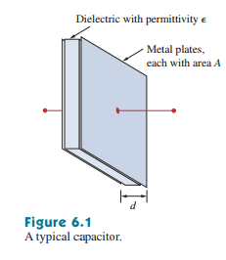

Capacitors
A capacitor is a passive element designed to store energy in its electric field.
Capacitors are used in electronics, communications, computers and power systems.
Capacitor is defined as

Slide 4
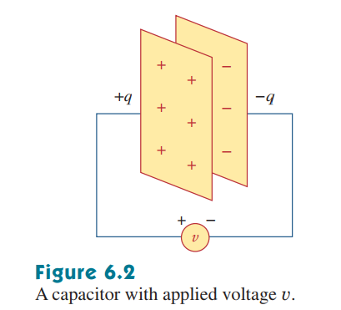
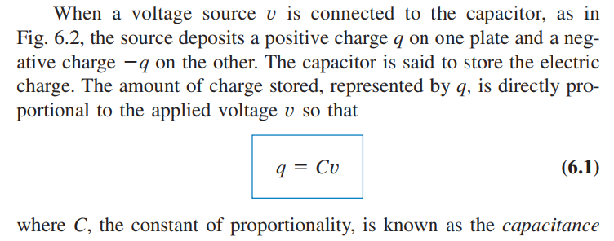


Slide 5
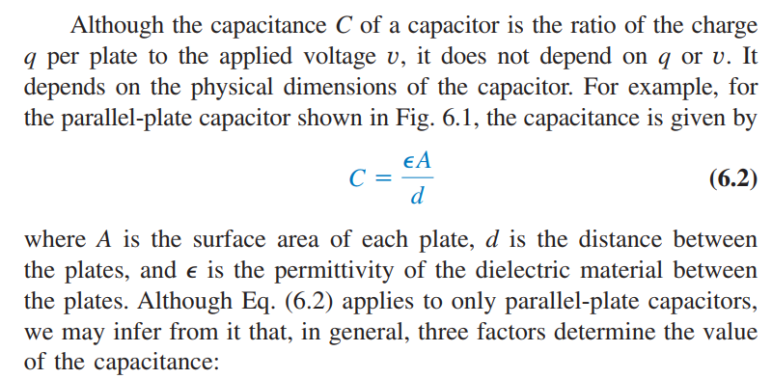
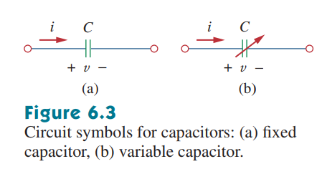


Slide 6
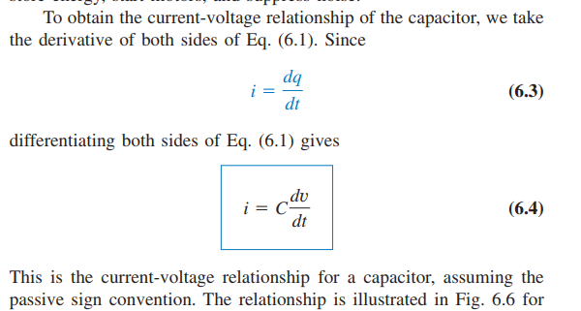
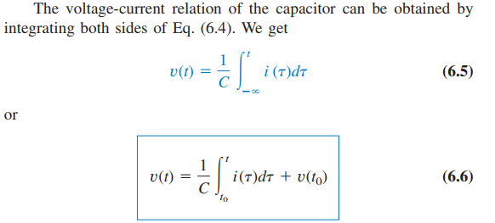

Slide 7
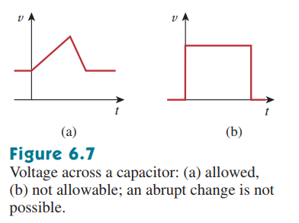
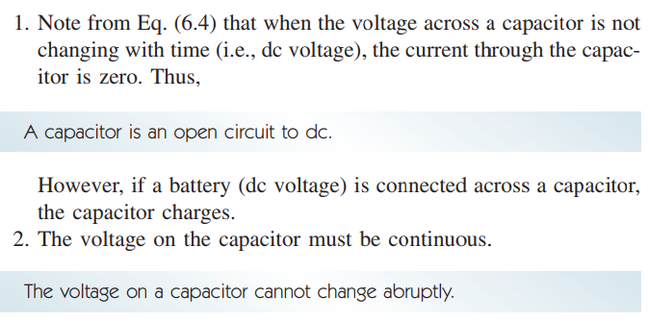

Properties of Capacitors

Slide 8
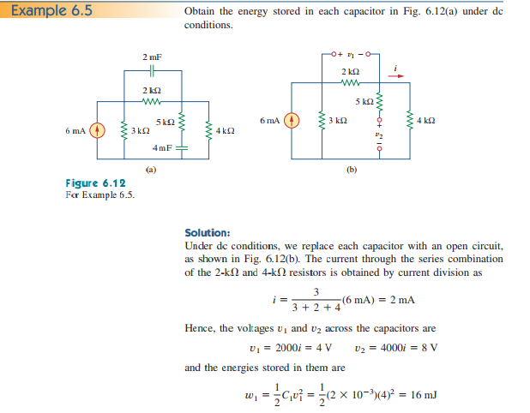


Slide 10
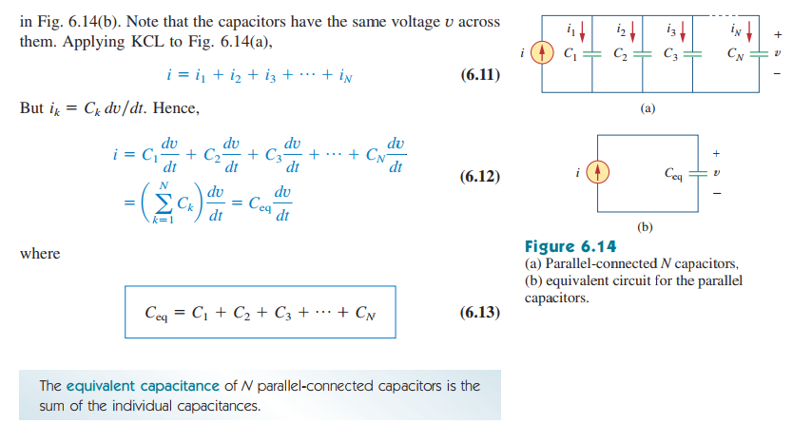
Capacitors in parallel

Slide 11
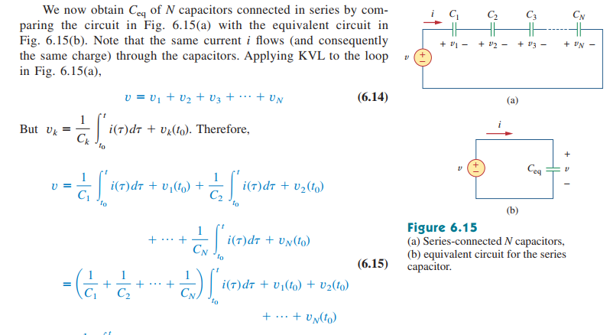
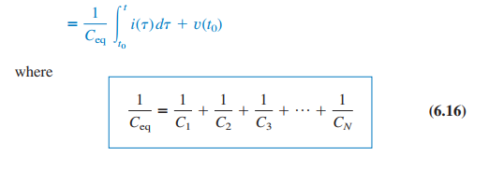
Capacitors in series

Slide 12

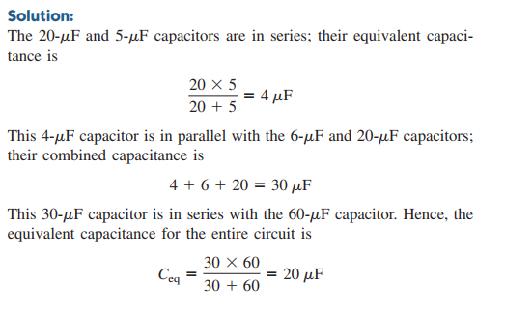

Slide 13
